Slide 1
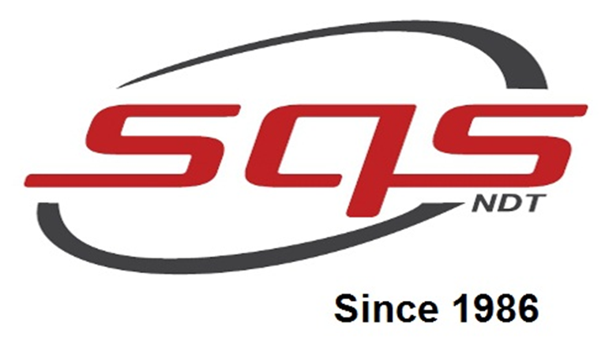
Super Quality Services
(A Successful NDT Pacesetter)

Slide 2
Overview of the company
Company established since 1986
We serve 7 places in INDIA,3 places in ASIAN Countries & 2 in MIDDLE EAST
Being a company dedicated to NDT we at SQS offer all scopes of testing components.

Slide 3
Advance NDT Division Overview
Laser Shearography
Digital Image Correlation
Eddy Current Testing
Phased Array Ultrasonic Testing
Long Range Ultrasonic Testing
Betatron (7.5&10 MeV)
LINAC(9MeV)

Slide 4
Overview of Digital Image Correlation

Slide 5
Digital Image Correlation(DIC)
POSSIBILITIES OF TESTING
DETECTABLE DEFECTS
Fracture Mechanics
Real Time Correlation
DIC for bridge inspection
Post-burn scars and scar contractures
Microspecimen
Wrinkles
Disbonds
Delamination
Cracks
Crushed core
Kissing bonds
Fluid ingress
Cracked cores
Porosity
Voids
Foreign objects
Impact damage (BVID’s)

Slide 6
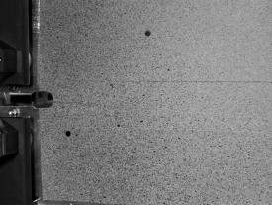
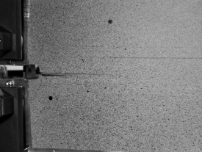
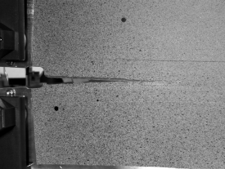
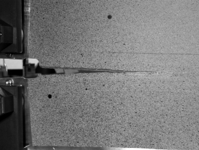
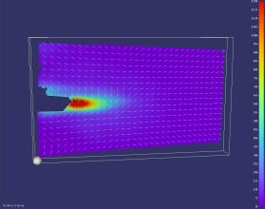
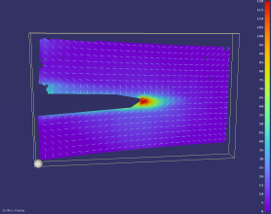
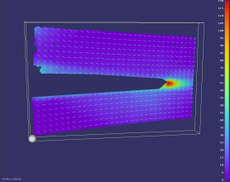
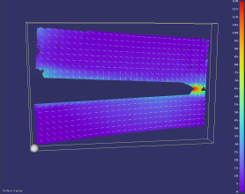
Application in Fracture Mechanics
Live image series
Development of principal strain
(Courtesy of University of the Federal Army, Munich, Prof. Rapp)

Slide 7
Real Time Correlation

Slide 8
DIC for bridge inspection
DIC CAMERA
TARGET

Slide 9
SPECKLE PATTERN
SPECKLE PATTERN
DIC CAMERAS

Slide 10
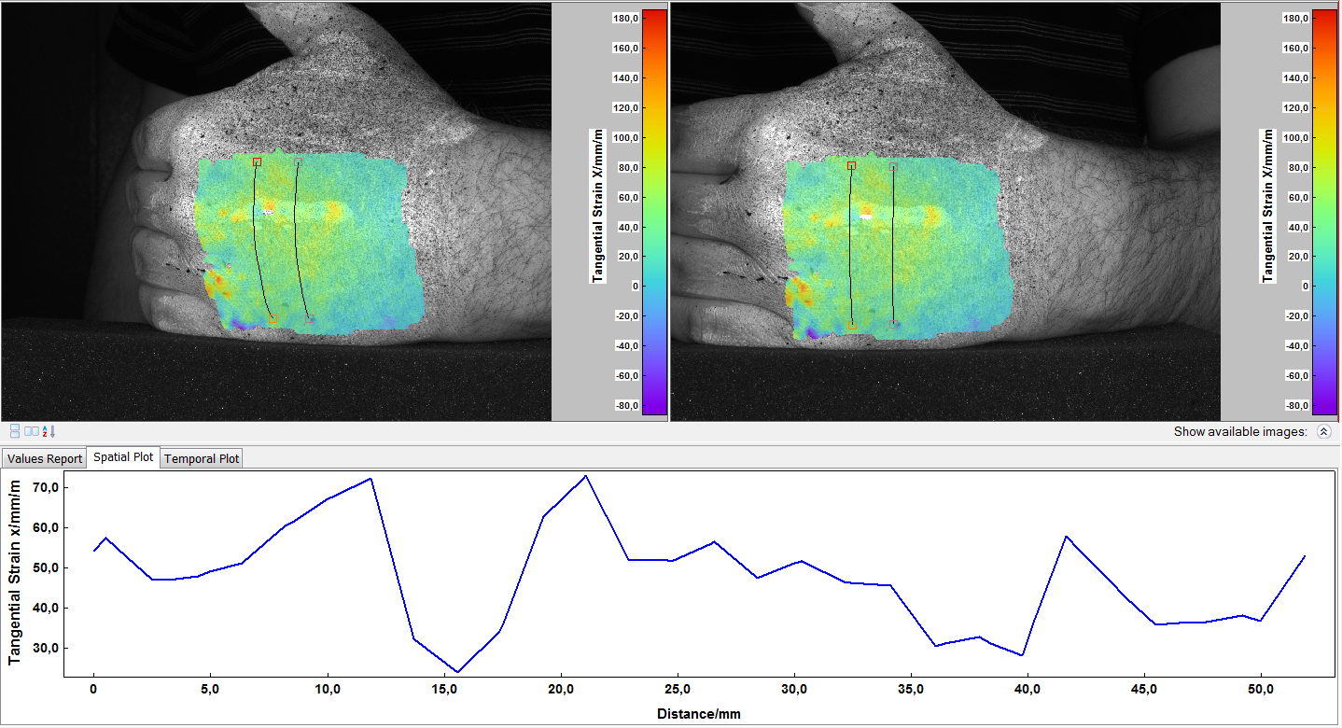
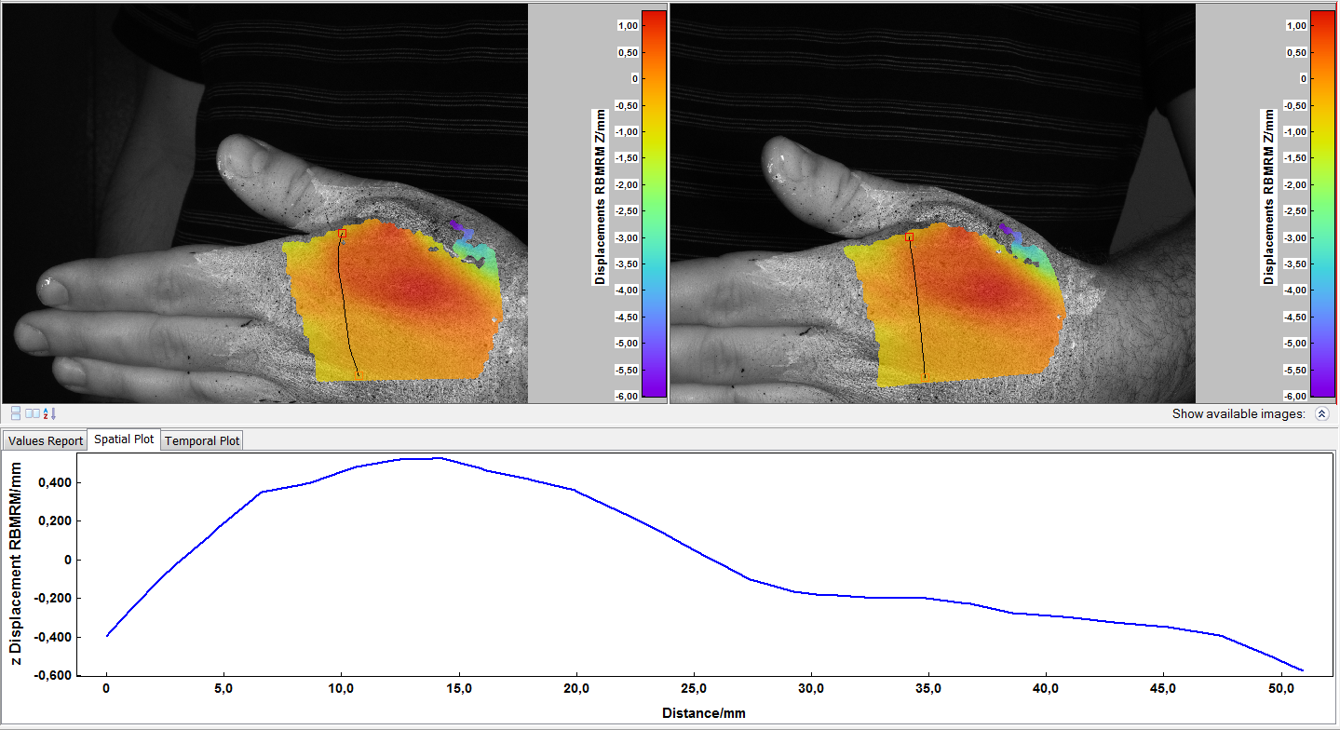
Post-burn scars and scar contractures

Slide 11
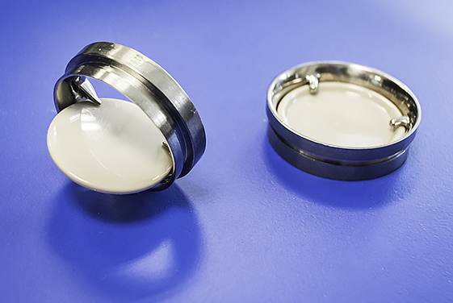
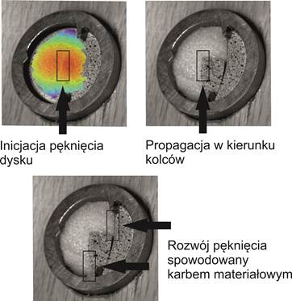
Microspecimen examples – heart valves
Yearly in USA about 100,000 heart valve replacements. (Vesely, I. Heart Valve Tissue Engineering. Circulation Research (97):743-755. 2005)

Slide 12
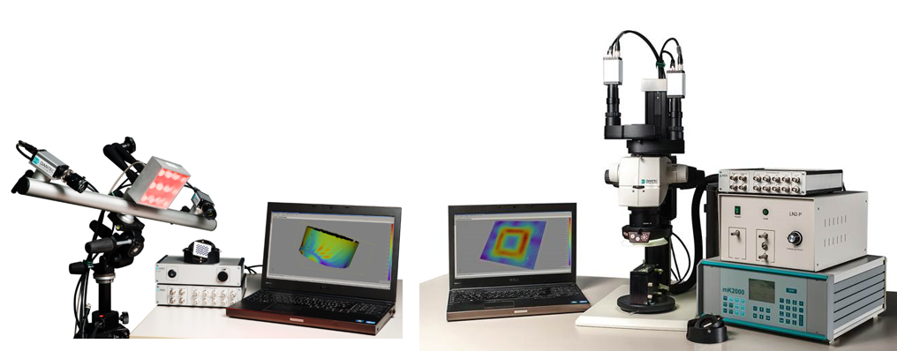
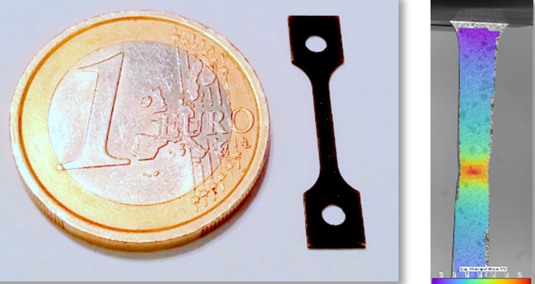
SUMMARY
3D deformation and strain analysis
Full-field - Non-contact
Robust and flexible
Results easy to extract: Contour, Displacements, Various Strains Tensors, ASCII, STL data, Scilab, ANSYS, FEM, HDF5, Animations, Plots, etc.
Almost on any material !
High-speed, low-speed, time lapse, cycle tests, temp. test, fracture mechanics
Real-time correlation
360 Degrees - for round specimens
Young Modulus, Poisson Ratio, CTE…..

